Slide 1




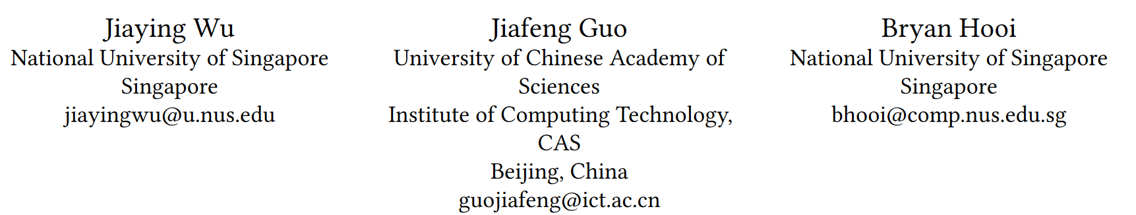





ATAI
Advanced Technique of Artificial Intelligence
ATAI
ChongqingUniversity _{AdvancedTechniqueof}
of Technology Artificial Intelligence
Chongqing University of Technology
Chongqing University ^{ATAI}
_{of Technology} Advanced Techniqueof
Artificial Intelligence
Chongqing University of Technology
Chongqing University of Technology
Fake News in Sheep’s Clothing: Robust Fake News Detection Against LLM-Empowered Style Attacks
code:https://github.com/jiayingwu19/SheepDog.
—— KDD ’24
Reported by Shu Ming Jiang
1

Slide 2
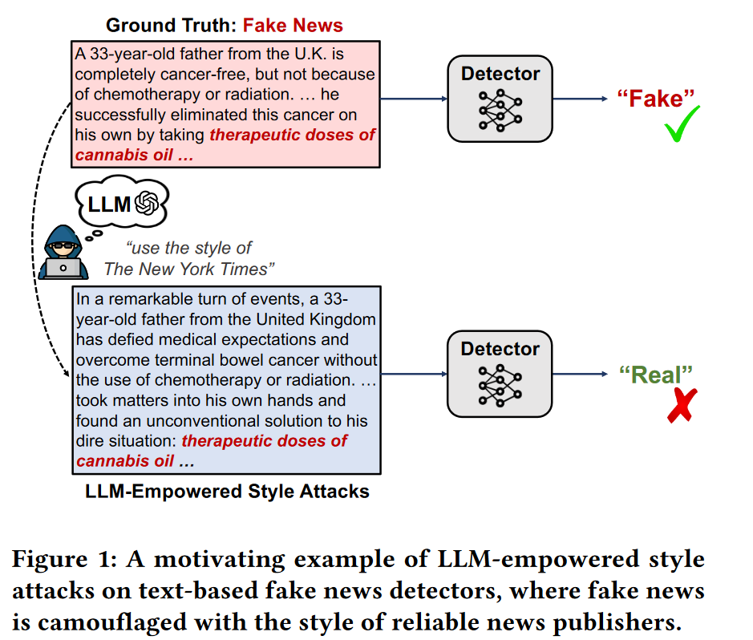
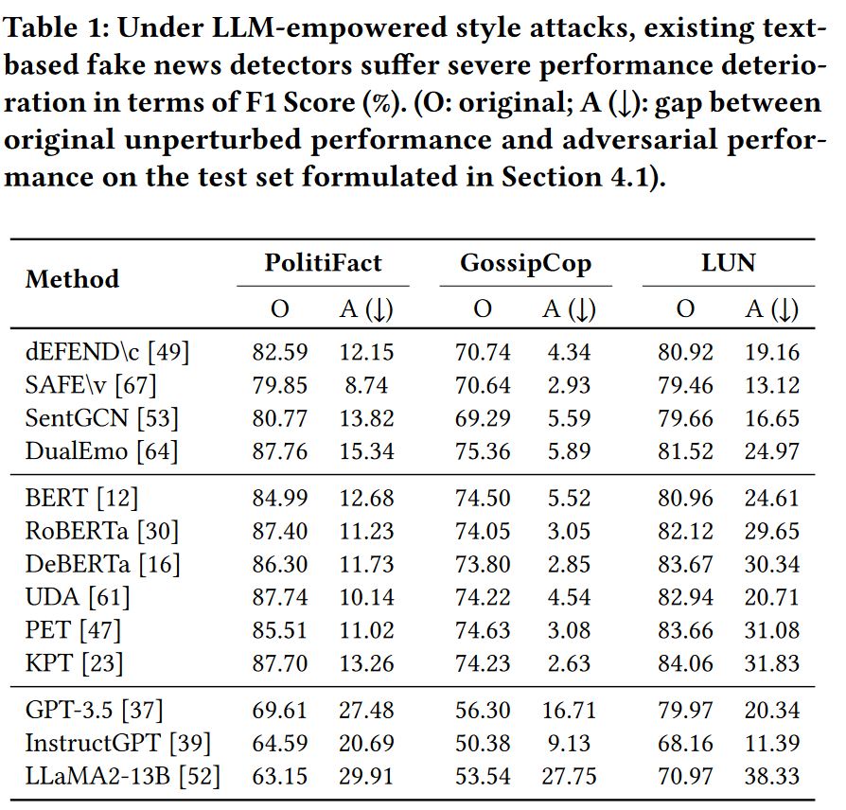
ATAI
Advanced Technique of
Artificial Intelligence
ATAI
ChongqingUniversity _{AdvancedTechniqueof}
of Technology Artificial Intelligence
Chongqing University of Technology
Motivation
1)The Large Language Models (LLMs) has empowered malicious actors to mimic the style of trustworthy news sources, doing so swiftly, cost-effectively, and at scale.
2)Our analysis reveals that LLM-camouflaged fake news content significantly undermines the effectiveness of state-of-the-art text-based detectors (up to 38% decrease in F1 Score), implying a severe vulnerability to stylistic variations.

Slide 3
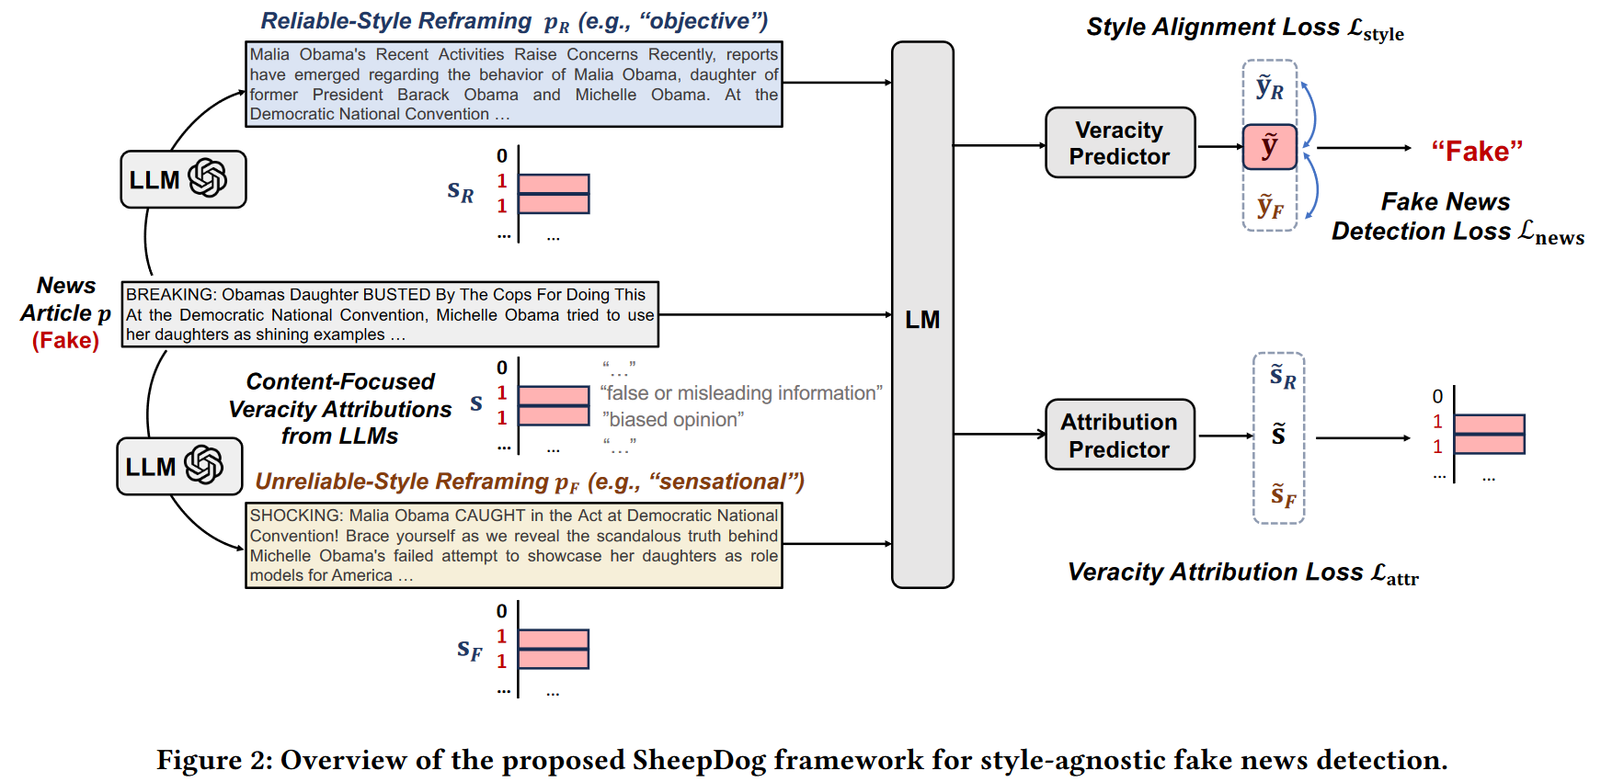
ATAI
Advanced Technique of
Artificial Intelligence
ATAI
ChongqingUniversity _{AdvancedTechniqueof}
of Technology Artificial Intelligence
Chongqing University of Technology
Overview

Slide 4
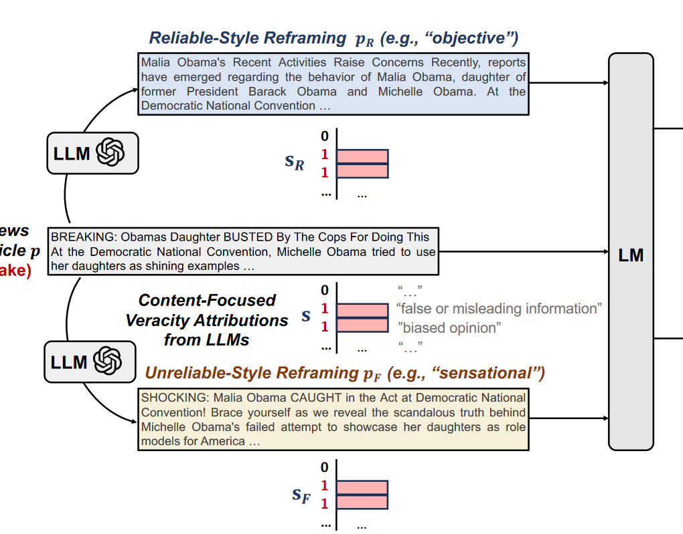
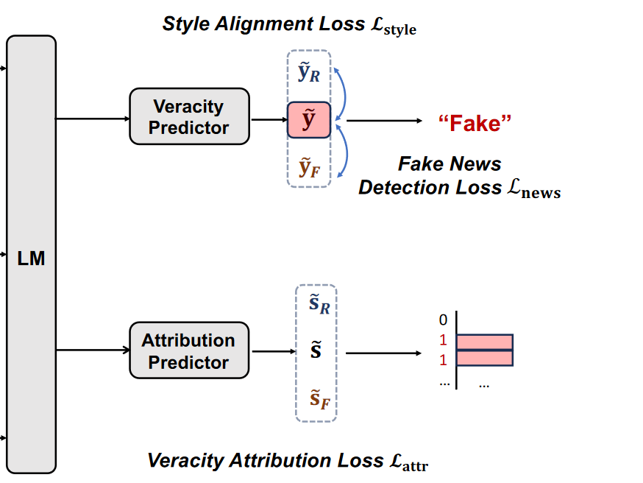
ATAI
Advanced Technique of
Artificial Intelligence
ATAI
ChongqingUniversity _{AdvancedTechniqueof}
of Technology Artificial Intelligence
Chongqing University of Technology
Method

Slide 5
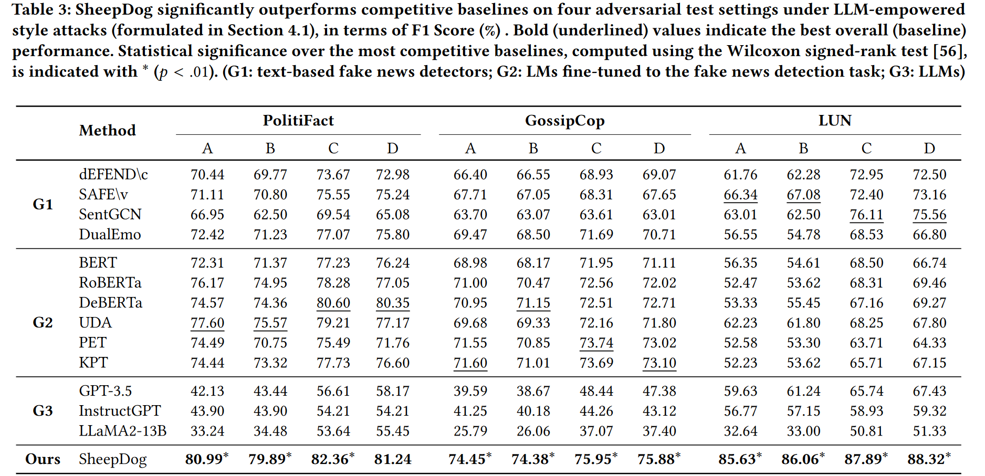
ATAI
Advanced Technique of
Artificial Intelligence
ATAI
ChongqingUniversity _{AdvancedTechniqueof}
of Technology Artificial Intelligence
Chongqing University of Technology
Experiments

Slide 6
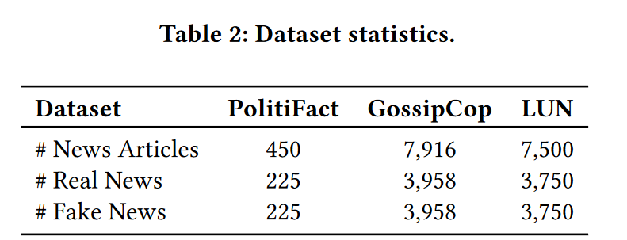
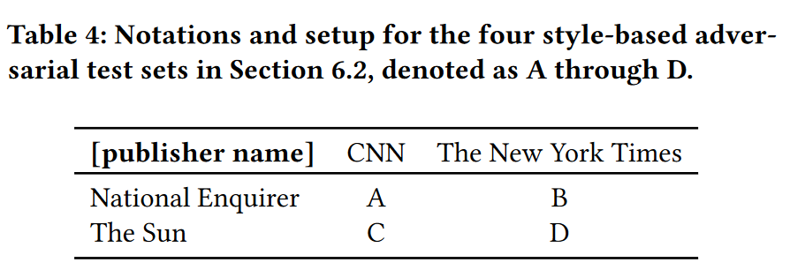
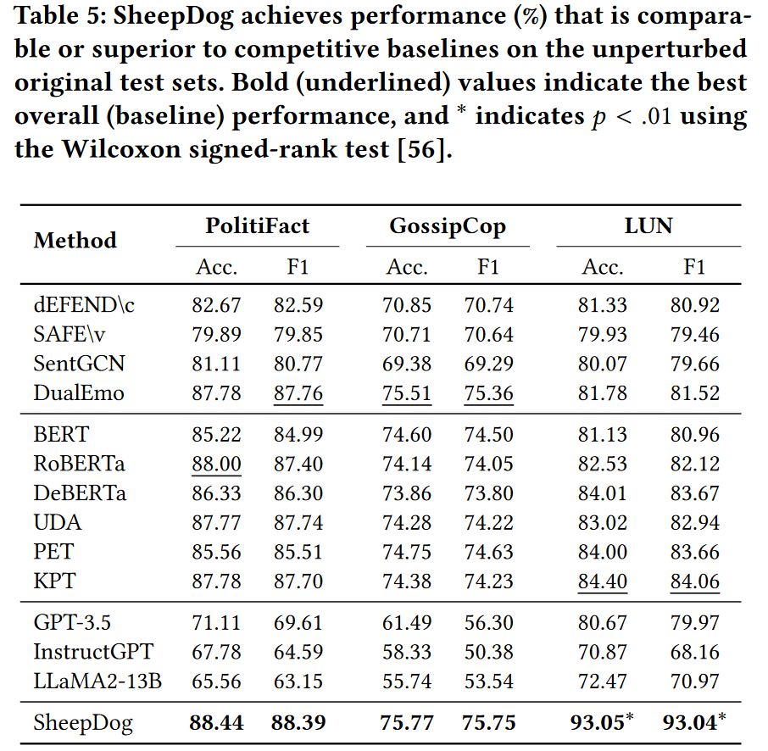
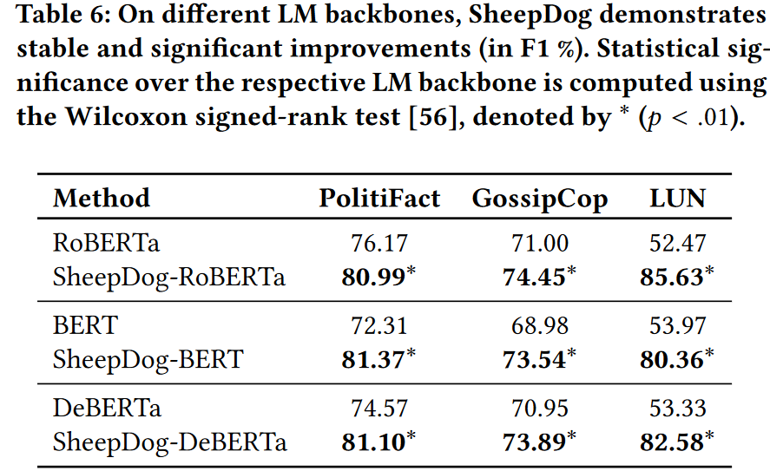
ATAI
Advanced Technique of
Artificial Intelligence
ATAI
ChongqingUniversity _{AdvancedTechniqueof}
of Technology Artificial Intelligence
Chongqing University of Technology
Experiments

Slide 7
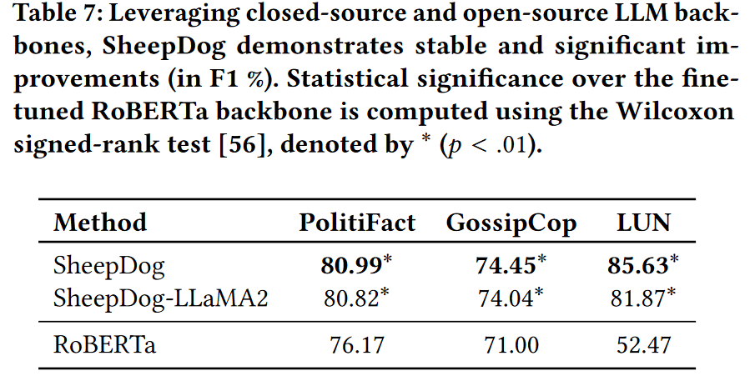
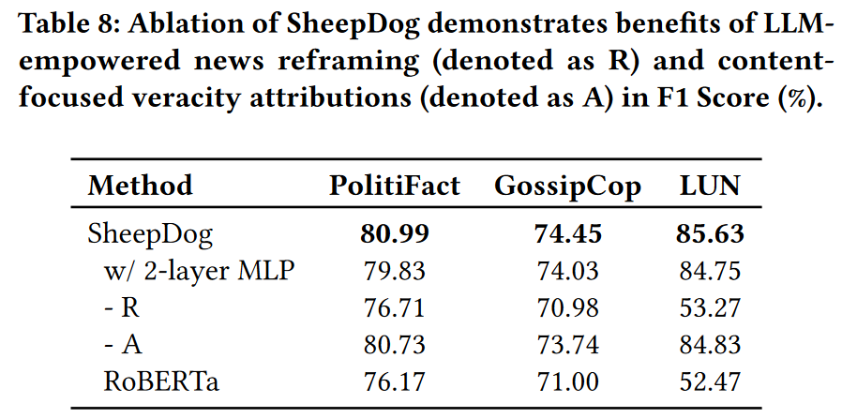
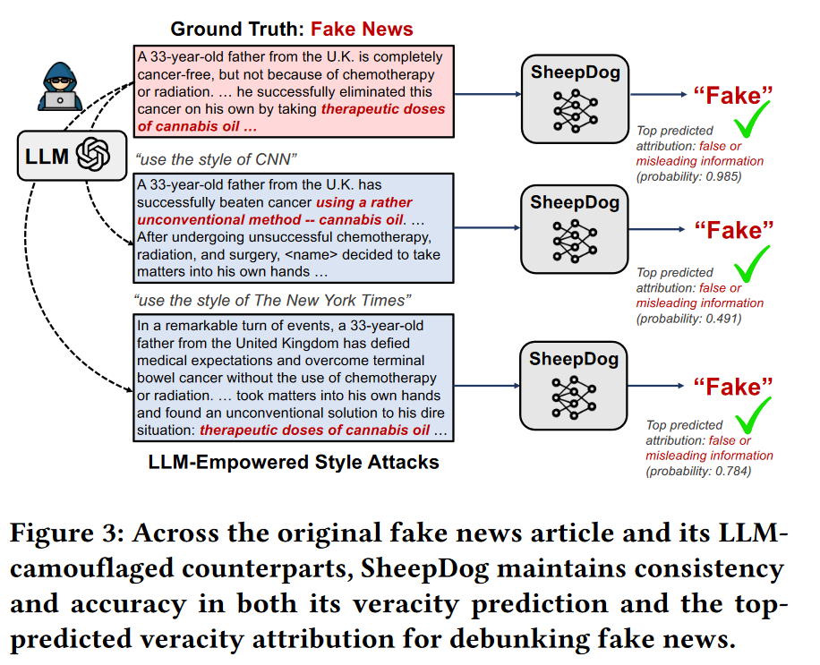
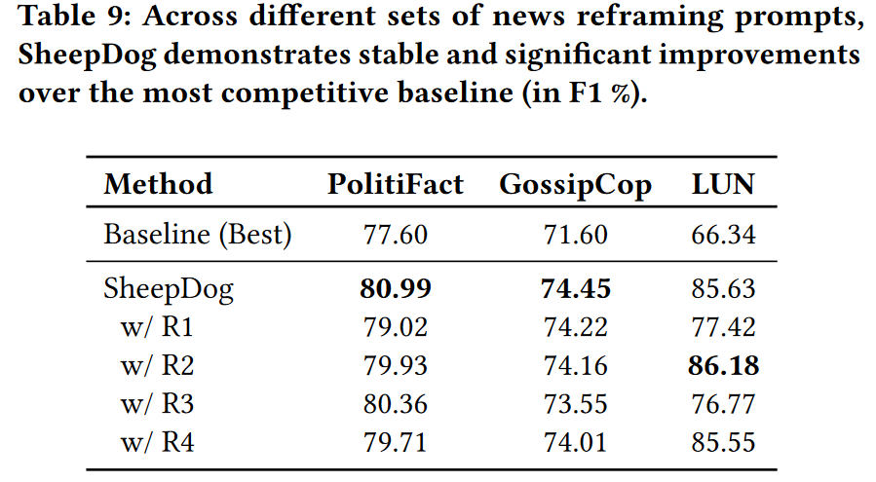
ATAI
Advanced Technique of
Artificial Intelligence
ATAI
ChongqingUniversity _{AdvancedTechniqueof}
of Technology Artificial Intelligence
Chongqing University of Technology
Experiments

Slide 8


ChongqingUniversity of Technology
ATAI
Advanced Technique of
Artificial Intelligence
ATAI
ChongqingUniversity _{AdvancedTechniqueof}
of Technology Artificial Intelligence
Chongqing University of Technology
Thanks!

